Slide 1
Acne Vulgaris
DR. DALIA SADEQ
DERMATOLOGY specialist
AL-ADAN hospital

Slide 3
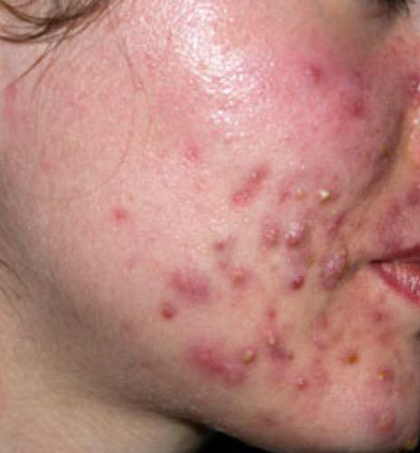
Introduction
Acne is an inflammatory disorder of the pilosebaceous unit
Characterized by comedones, papules, pustules , cyst and potential scarring

Slide 4
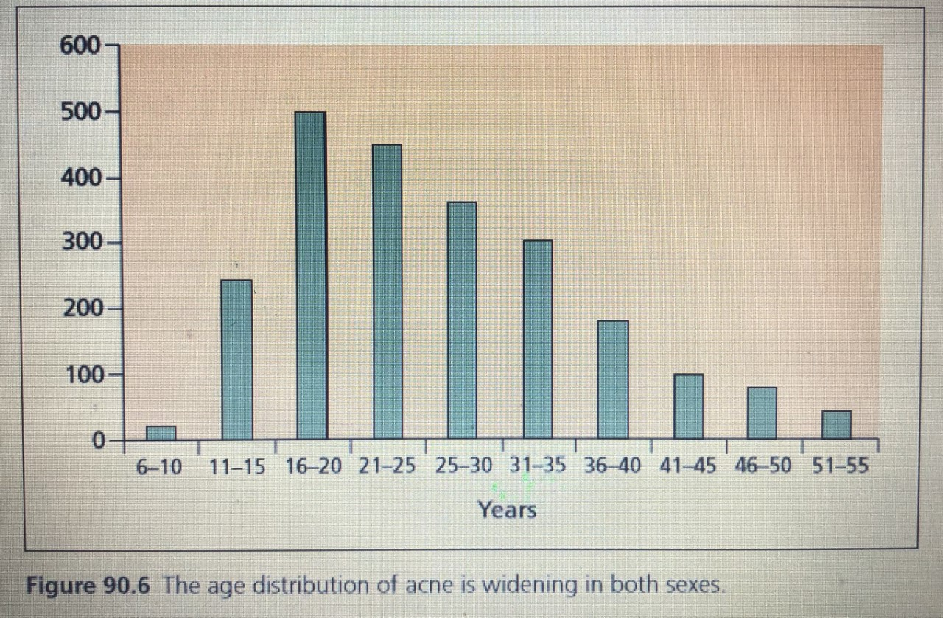
Age
Can occur in any age
peak incidence during adolescence
acne often continues to be problematic in adult.

Slide 5
Age groups
Infantile acne
1-6 years: acne is rare
7-11 years : comedonal acne
Post-adolescent acne: more in women
Premenstrual flares are common
only 20% of women with acne have irregular menses and may have signs of hyperandrogenism

Slide 6
Factors that may predispose to acne
Genetic :
Oily skin, Severity of acne , scarring , age of onset
Lifestyle and environmental factors :
Diet
Psychological stress
Cosmetics
Drugs
Seasonal factors
Menstrual cycle: 70% complain of flare 2-7 days prior
Pregnancy : may worsen or improve acne

Slide 7
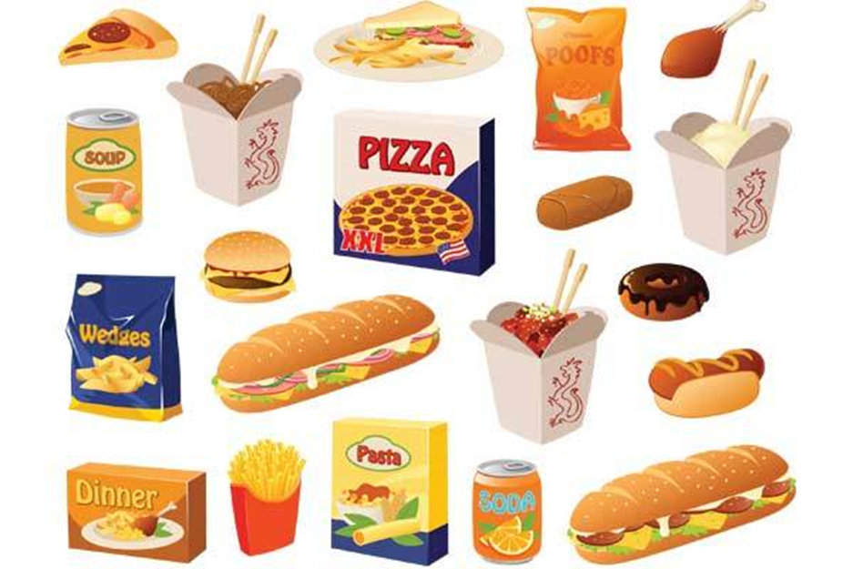
Diet
link between a high glycemic-load diet and acne risk
intake of milk, especially skimmed milk, is positively associated with acne prevalence and severity
whey protein supplements for body building
vitamin B ₁₂ supplementation
Advice :
Eat healthy diet with everything in moderation

Slide 8
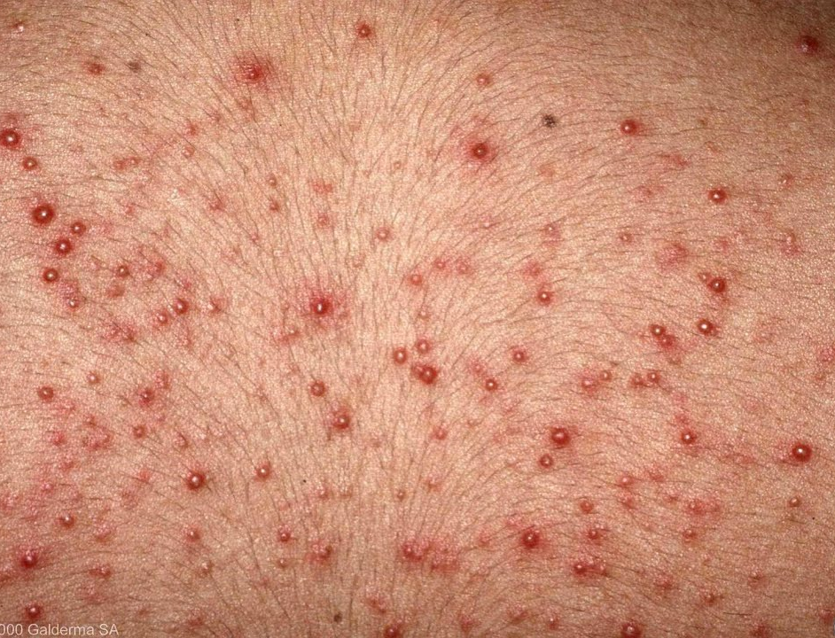
Drug-induced Acne or acneiform eruptions
monomorphous eruption of inflammatory papules and pustules
Common :
anabolic steroids , corticosteroid, isoniazid , lithium . Progestin , bromides, phenytoin, EGFR inhibitors
Uncommon :
vitamin b6, B12, cyclosporin, azathioprin, TNF inhibitors

Slide 9
Clinical features

Slide 10
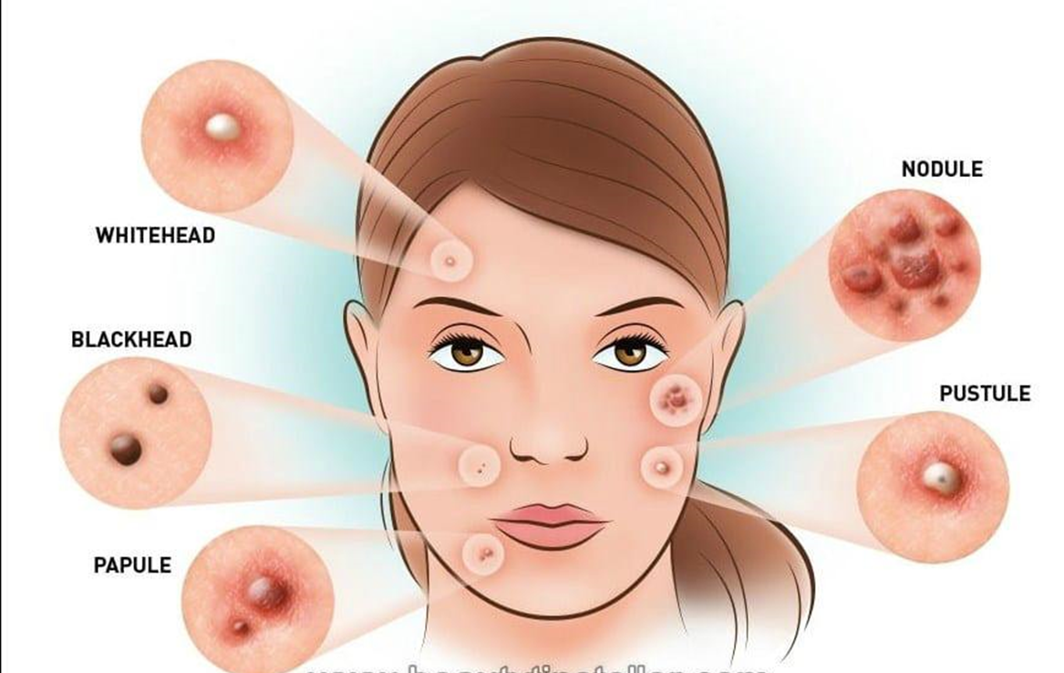
Clinical features
Acne is typically found in sites with well-developed sebaceous glands
most often the face and upper trunk
varying degree of seborrhea
Non-inflammatory acne
Inflammatory acne

Slide 11
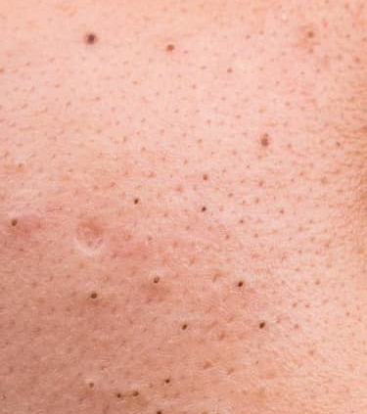
Non- inflammatory acne
open comedones (blackheads) have a dilated follicular opening filled with shed keratin

Slide 12
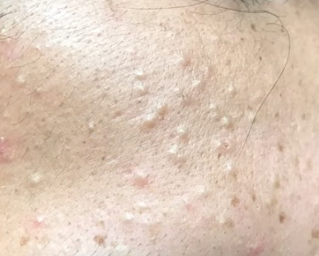
Non-inflammatory acne
Closed comedones (whiteheads) are small skin-colored papules.
better appreciated upon palpation, stretching, or side-lighting of the skin.

Slide 13
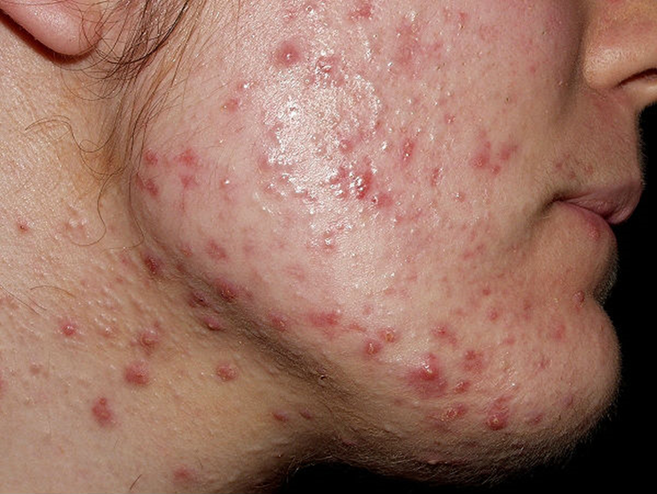
Inflammatory acne: papules, pustules

Slide 14
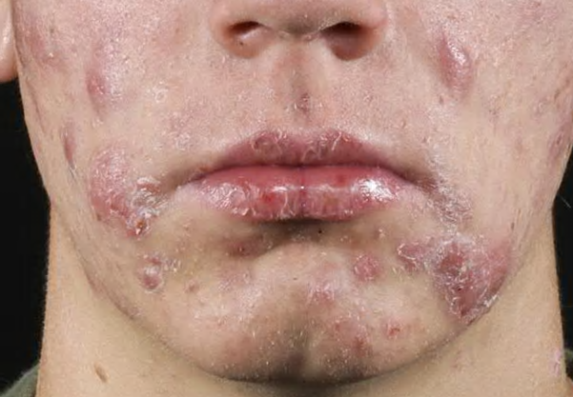
Inflammatory acne: nodules

Slide 15
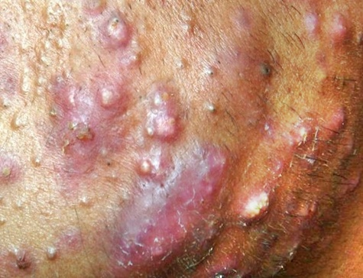
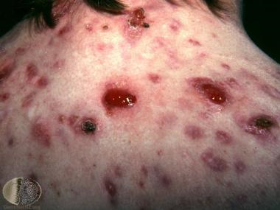
Severe Inflammatory acne
Acne conglobate
Acne fulminans

Slide 16
Acne management

Slide 17
history
Gender
Age
Lifestyle
Occupation
Current and previous treatment
Use of cosmetics , cleansers , sunscreen, moisturizers
Menstrual history
Medication: steroid , OCP, anabolic steroids
Concomitant illnesses
Family history : including severity of acne , polycystic ovary syndrome )

Slide 18
physical examination
Skin type ( oily vs dry )
Skin color/ phototype
Distribution of acne ( face , neck, chest, back, upper arm)
Degree of involvement ( mild, Moderate , severe )
Lesion morphology :
Comedones , papules, pustules, nodules, cysts , sinus tracts
Scarring : hypertrophic, atrophic
Post inflammatory pigmentary changes

Slide 19
Investigations

Slide 20
Investigation
Majority of patient have no abnormality
Individuals at increased risk of acne : endocrine disorders such as polycystic ovarian syndrome, hyperandrogenism, hypercortisolism, and precocious puberty.
Acne reported to be :
Therapy resistant acne
Rapidly relapsing
Very severe
Marked seborrhea
Sudden onset

Slide 21
Children
thorough history and physical examination to rule out endocrine or precocious puberty or abnormal growth
Consider the possibility of an underlying hyperandrogenic condition such as premature adrenarche, congenital adrenal hyperplasia, or an androgen-secreting tumor

Slide 22
Why to treat ?

Slide 23
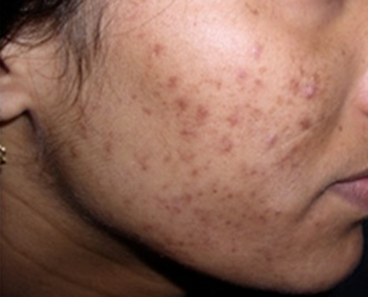
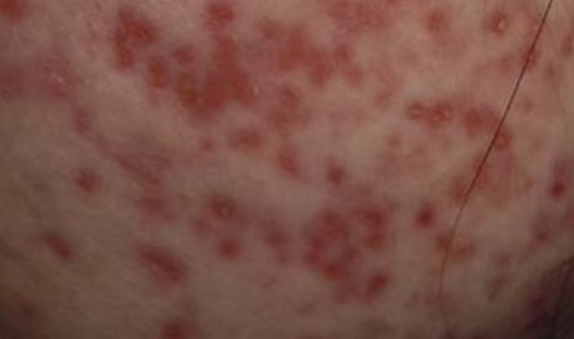
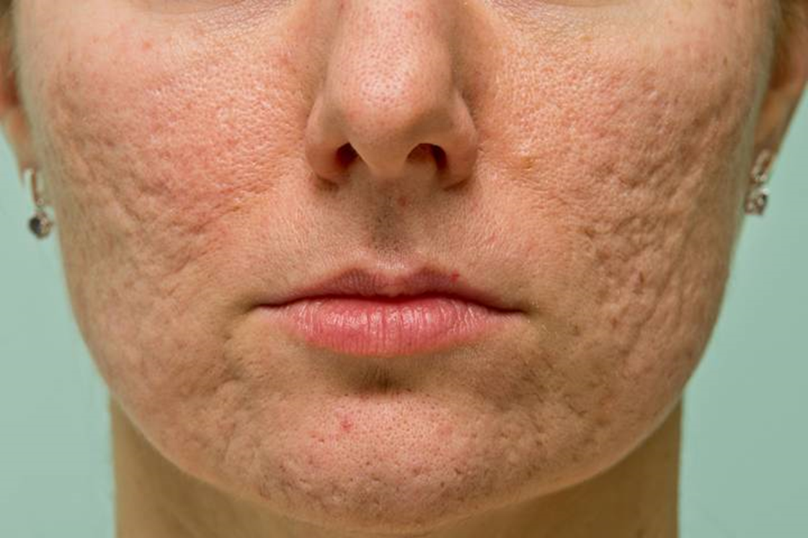
Acne complications
Psychosocial impact
Pigmentary changes : Erythema and post-inflammatory hyperpigmentation
Acne scars :
pitted scars or atrophic ( rolling, ice-pick, box scar )
hypertrophic scars and keloid (most commonly on the trunk;
Even mild acne can cause scarring early treatment is essential for the prevention of lasting cosmetic disfigurement

Slide 24
Management
topical medications (especially retinoids) should be used to the entire acne-prone region rather than as “spot treatment” of individual lesions
Minimize irritation
start gradually: small amount, single agent for 2 weeks then add another or alternative days
Proper daily skin care routine :
Facial cleanser , non-comedogenic oil free sensitive skin moisturizer and sunscreen
Instruct patients not to pick or manipulate lesions
6-8 weeks for substantial improvement

Slide 25
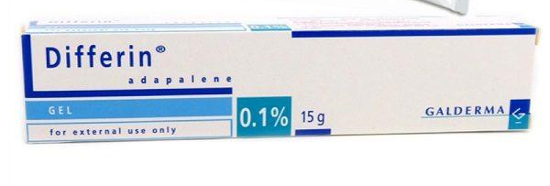
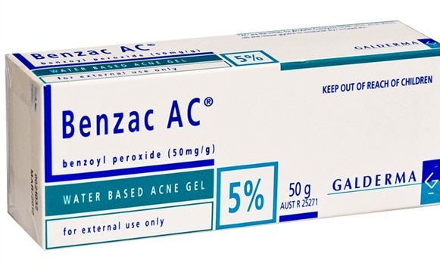
First line acne treatment : topical

Slide 26
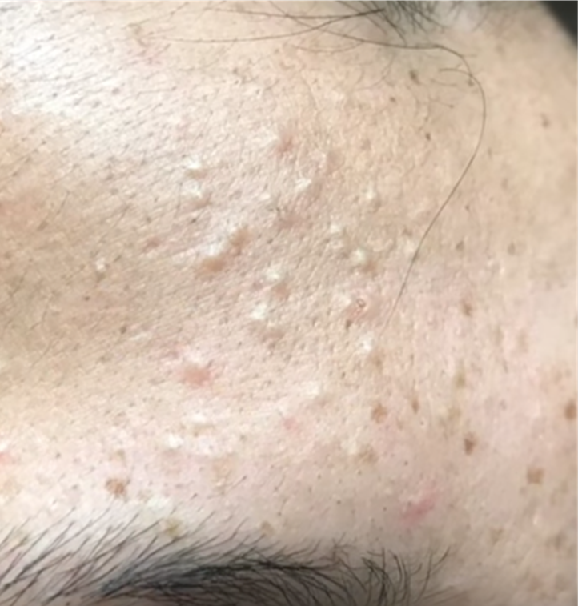
Comedonal acne
Topical retinoids
Fixed combination retinoids and BPO ( Epiduo )
azelic acid
Salicylic acid
Comedo extraction

Slide 27
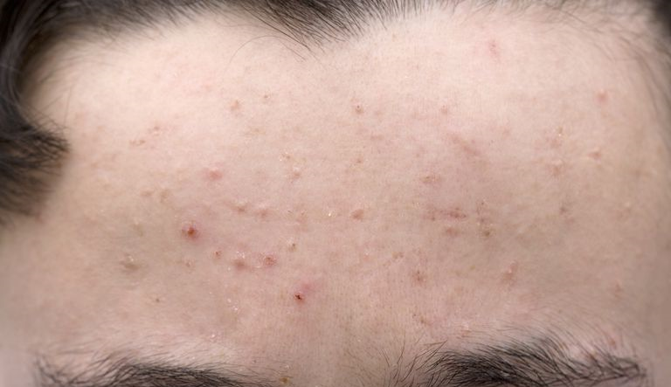
Papulopustular acne : Mild
Topical retinoids + BPO
Topical retnoids + topical antibiotics
or
BPO +/- topical antibiotics
Second line
Alternative topical retinoids ( or higher concentration ) or antimicrobial
Azelic acid
Salicylic acid

Slide 28
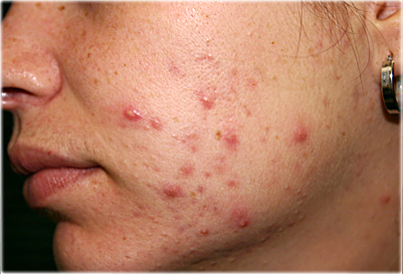
Moderate inflammatory acne
Oral antibiotics + topical retinoids +/- BPO
or
Topical retinoids + BPO +/- topical antibiotics
Second line :
Alternative oral antibiotics + alternative topical retinoids +/- BPO / azelic acids
Hormonal therapy for female

Slide 29
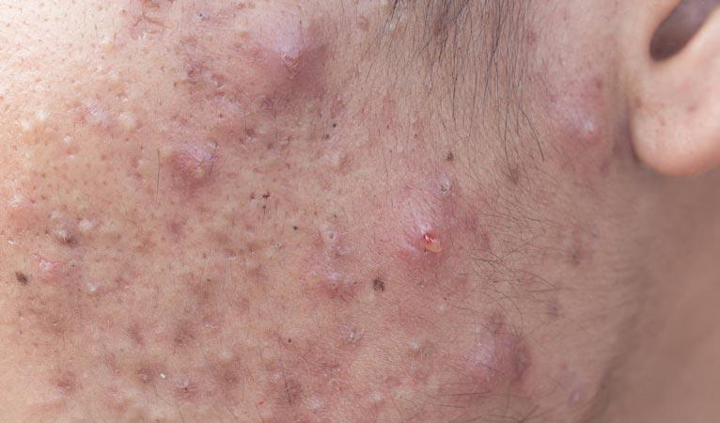
Severe acne
Oral antibiotics + topical retinoids with BPO
Or
oral isotretinoin
Hormonal therapy for female
Procedural :
comedo extraction / intralesional steroids for nodules

Slide 30
Maintenance therapy
Topical retinoids
Topical retinoids with BPO
If not tolerated use azelic acid

Slide 31
Acne treatment in pregnancy
Azelic acid ( pregnancy category B )
Benzoyl peroxide ( catogery C )
Salicylic acid ( C ) safe esp. if restricted to small area
Topical antibiotics : erythromycin and clindamycin
Oral treatment for short duration : macrolides; erythromycin and azithromycin , cephalexin , amoxicillin
Avoid topical retinoids
Avoid tetracycline ( effect on fetal teeth and bone )
Avoid isotretinoin ( craniofacial malformation , CVSm thymus and parathyroid glands
Avoid spironolactone

Slide 32
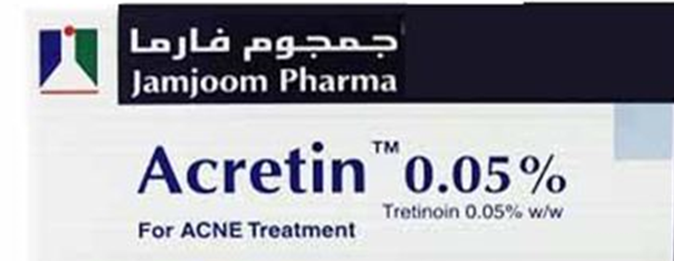
Topical retinoids
Comedolytic & anti-inflammatory properties
monotherapy for acne with both comedonal and mild papulopustular acne
also effective for treatment of photoaging , dilated pores, reduce risk of acne scarring and pigmentation

Slide 33
To improve adherence to retinoids
Educate patient that irritation/ flare can be part of the treatment process in the first month
A small dose of retinoid (pea-sized) applied in a thin layer to the entire affected area
Titrate retinoid dose at initiation ( first 2-4 weeks )
Apply retinoid every other day at night
Use a short contact method (apply to full face for 30-60 minutes then wash off)
start with lower concentration then increase
transient application of a low-potency topical corticosteroid if significant irritation

Slide 34
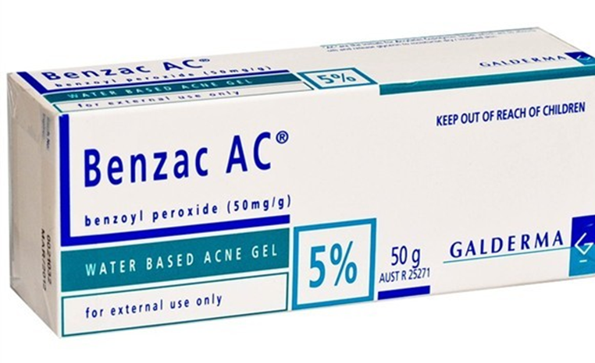
Benzoyl peroxide
bactericidal agent with no microbial resistance
concentrations ranging from 2.5% to 10%
As benzoyl peroxide is a bleaching agent, whitening of clothing and bedding can occur.
Side effect: development of contact dermatitis
Use : once up to three times a day small amount to clean dry skin

Slide 35
Adapelene + benzoyl peroxide

Slide 36
Don’t

Slide 37
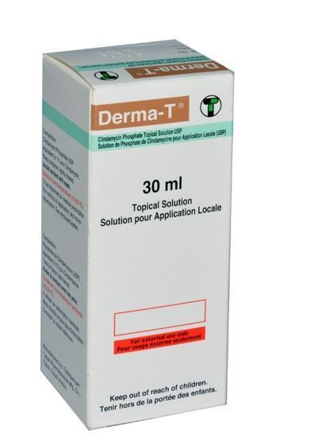
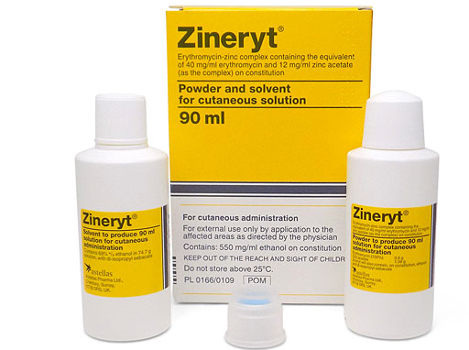
Topical antibiotics
Twice a day
Avoid monotherapy

Slide 38
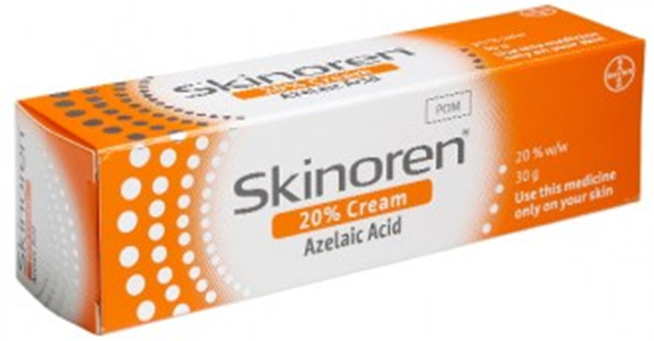
Azelic acid
effective in inflammatory and comedonal acne
applied twice daily
it may help to lighten post-inflammatory hyperpigmentation
Side effect : pruritis , burning/ stinging, dryness, peeling

Slide 39
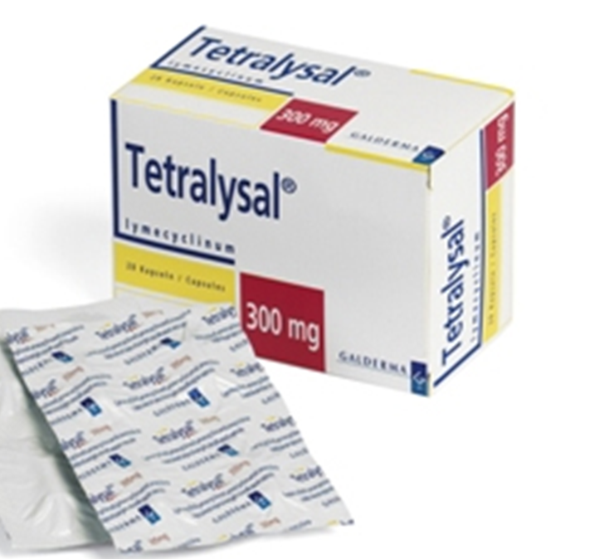
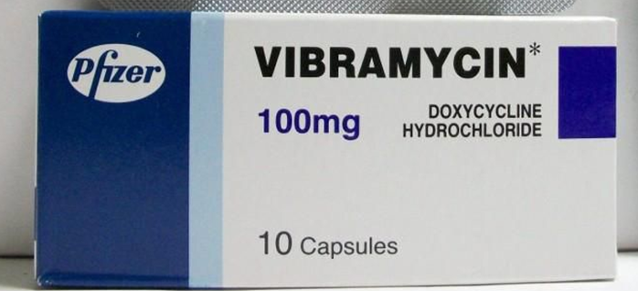
Oral antibiotics
indicated for moderate- severe acne
Response should be evaluated at 6-8 weeks
First line : oral tetracycline derivatives, especially doxycycline, lymecycline, minocycline
If contraindicated ( pregnancy, children < 8 yrs , allergy ):
macrolides such as erythromycin and azithromycin
Others : Trimethoprim/ sulfamethaoxazole, amoxicillin and cephalexin

Slide 40
Limit antibiotic usage to preserve antibiotic sensitivity
Do not use topical or systemic antibiotic as monotherapy
If topical or systemic antibiotic is prescribed add BPO or topical retinoids ( faster and superior clearing )
Target duration of therapy less than 3-4 months
If repeated courses of antibiotics are required and the initial response was favorable reuse the same drug
Avoid prescribing different oral and topical antibiotics concomitantly
Check medical adherence ( poor adherence to antibiotic promotes resistance )

Slide 41
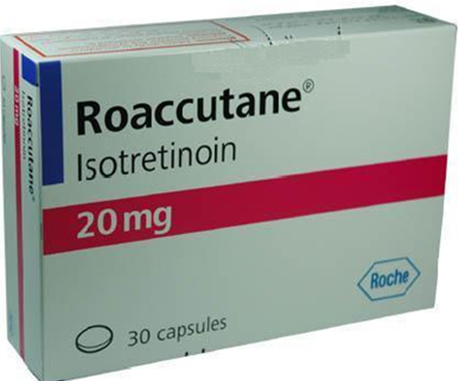
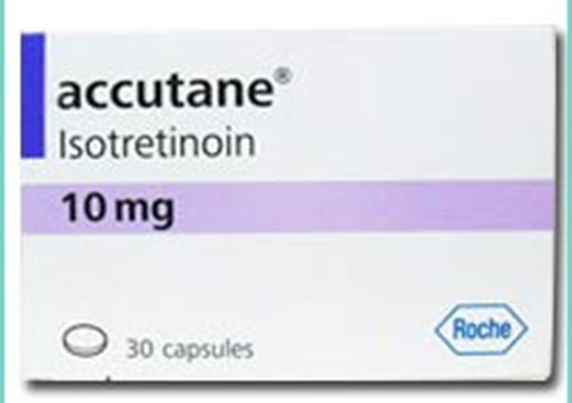
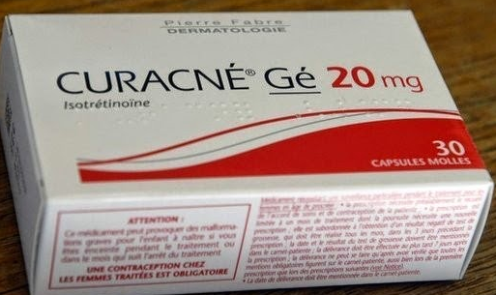
Isotretinoin
Recommended for the treatment of severe nodular acne , acne fulminans and acne conglobata (first-line )
Treatment of moderate acne that is resistant to other treatment

Slide 42
Common minor side effect
The most common adverse effects of isotretinoin involve the skin and mucous membranes and are dose-dependent.
Cutaneous Xerosis ‘Retinoid dermatitis’ Photosensitivity Hair Telogen effluvium Abnormal hair texture, dryness Nails Fragility with nail softening Paronychia | Ocular Dry eyes with visual blurring Oral Cheilitis – especially lower lip Dry mouth Nasal Nasal mucosa dryness Epistaxis | Musculoskeletal Arthralgias Myalgias Neurologic Headache Gastrointestinal

Slide 43
serious side effect
Teratogenicity is a serious potential complication
must practice effective contraception for 1 month prior to, during, and for 1 month after completing therapy
Rare: pseudotumor cerebri (Benign intracranial hypertension )
If headache accompanying nausea, vomiting, and visual changes .
avoid combining isotretinoin with tetracycline, doxycycline, or minocycline .

Slide 44
Side effect
elevated serum triglyceride and/or cholesterol
severe elevations are uncommon
Slight to moderate elevations: managed with weight reduction, increased physical activity, and diet.
Lipid elevations are reversible on cessation of therapy
occasionally elevated transaminases
discontinuation recommended only for severe (>3-fold) elevations,
dose reductions should be considered for smaller transaminase elevations
elevated creatine phosphokinase levels:
myalgias in patients undergoing physical training programs involving heavy exertion

Slide 45
Side effect
Bone : short duration treatment > no adverse effects on bone or ligaments
Controversial :
Inflammatory bowel disease
risk depression and suicidal behavior

Slide 46
Hormonal therapy
Oral contraceptive pills
Spironolactone
cyproterone acetate
Flutamide
Hormonal therapy is an established second-line treatment for female patients , effective, irrespective of whether or not the serum androgen levels are abnormal.

Slide 47
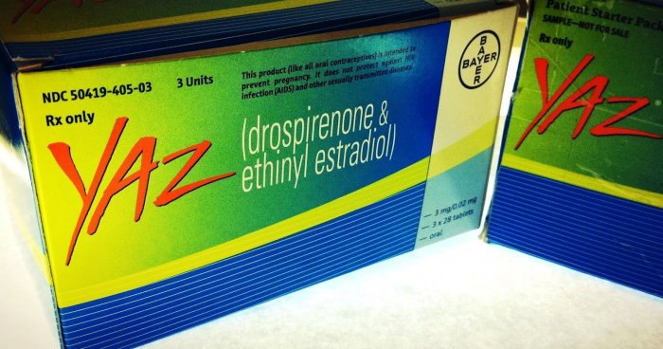
Hormonal therapy
Combined oral contraceptive pills, which block production of androgens, are effective for inflammatory acne.
Age : > 14-15
Can be combined with other acne treatment ( effect is not evidence in first months )
Note:
- progestin may trigger acne : injectable contraception or intrauterine device

Slide 48
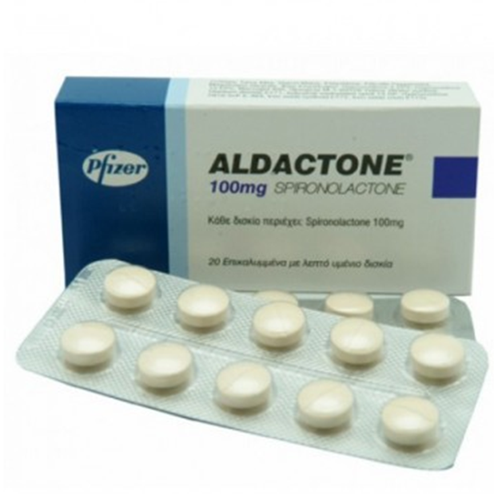
Spironolactone
Anti-androgen
reduce sebum production and improve acne
50–200 mg / day
Side effects : include irregular menstrual periods, breast tenderness, headache, and fatigue.
monitoring of potassium is not required in young healthy patients .
risk of feminization of a male fetus
As with other hormonal therapies, a clinical response may take up to 3 months

Slide 49
Other treatment option for acne
laser, intense pulse light , photodynamic therapy but should not be considered first line treatment for inflammatory acne
Chemical peel like salicylic acid peel or glycolic acid peel : decrease acne, scarring and pigmentation

Slide 50
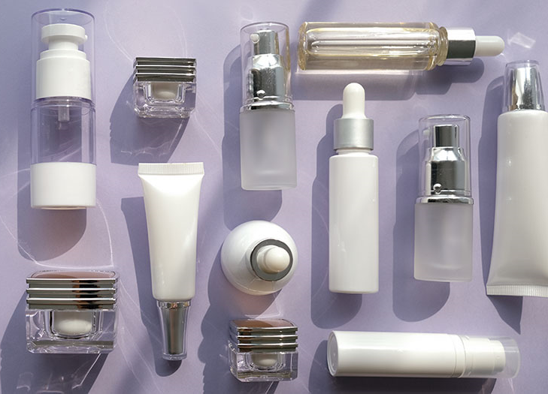
cosmeceuticals
Salicylic acid : comedolytic and antibacterial agent , available over the counter in concentrations of up to 2%
Alpha hydroxy acids
Vitamin C
Tea tree oil
Niacinamide
Green tea extract
Resveratrol
Zinc
benzoyl peroxide wash
Retinyl propionate and retinol

Slide 51
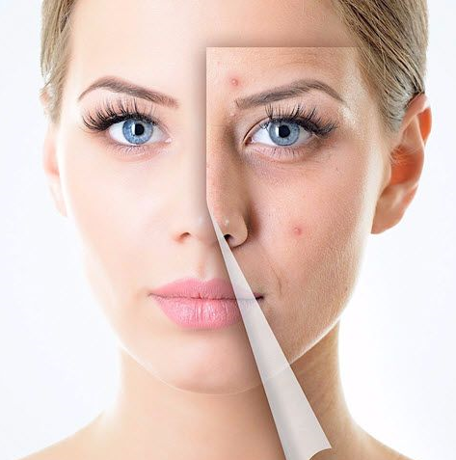
The end

